Slide 1
The Prescriptive Software Development Process
Chapter 3

Slide 2
Lifecycle Models
A Lifecycle Model is an approach to building software systems.
A non-specific, suggested set of lifecycle phases and activities that lead to a successful project e.g. Prescriptive vs Agile Models.
The Prescriptive Model describes (prescribes) a set of activities and artifacts that guide the development team to a successful conclusion.
Both Waterfall and Unified Process are prescriptive.
The Agile Model abandons most mandated activities in favor of an approach that relies on the team to self-organize and produce systems that are complete and correct.
We will cover Agile processes in a future section.
Notes:
A lifecycle model better resembles a philosophy to building software systems.
The Agile model minimizes the overhead of a prescriptive process by substituting the management of the team with a team that self organizes and executes the project to a successful conclusion.

Slide 3
Development Process based on Prescriptive
A Software Development Process is a specific set of phases, activities, and artifacts (deliverables) that an organization adopts as “our process for building software systems”.
An organization starts with a lifecycle model and tailors the activities and artifacts according to their needs.
The organization formally defines their artifacts i.e. the documents, procedures, signoffs, etc. that must be applied to move a project though their process.

Slide 4
The Generic Waterfall Process
The Six Generic Phases of the Waterfall Processes…
Requirements
Analysis
Design
Implementation
Integration Testing
Delivery

Slide 5
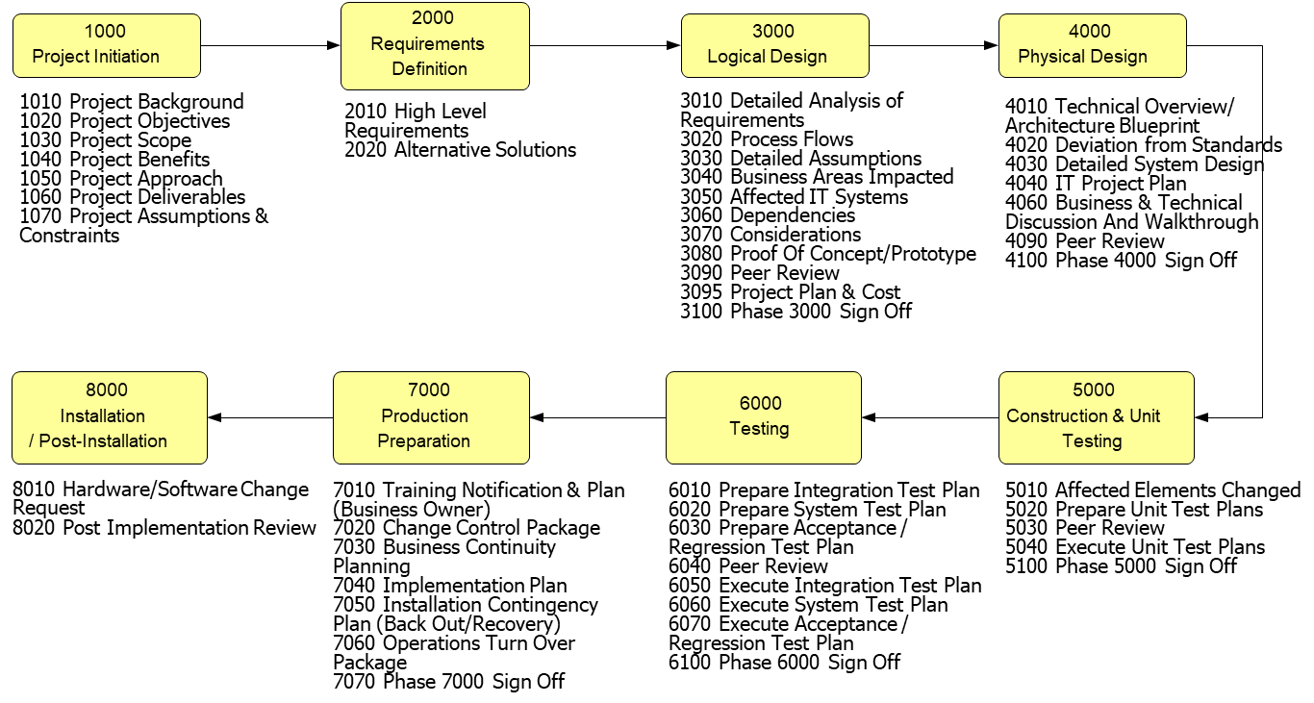
A Development Process based on Waterfall

Slide 6
The Structure of a Software Dev. Process
A process describes the steps / procedures the team follows when executing their software development projects.
A series of steps the team follows / executes.
A waterfall process divides the project lifecycle into phases and describes what the team produces during each phase.
The project is divided into Phases (requirements, analysis, design, etc. ) that are executed linearly during the project.
Phases are associated with Activities the team performs individually or as a group while they execute the phase.
Most Activities produce Artifacts (document, model, etc.) that are retained and usually contribute to the next phase’s activities.
Notes:
Phases / Activities / Artifacts.

Slide 7
How does an organization define the SD process to be applied to their development efforts?
A software development process (activities and artifacts) can be ‘learned’ from a book.
Booch, Rumbaugh, Sutherland, and other authors have written books that describe specific OO software development processes.
But in practice, these off-the-shelf processes are rarely executed as described by their authors.
Most organizations create their own unique process which they follow during their project’s lifecycles.
The organization may base their process from a published process and extend in ways that best addresses their application’s requirements and organizational resources.

Slide 8
An Organization builds their Software Development Process to address their Unique Situation
Two considerations when defining a process are:
What impact will the process have on the development team’s productivity?
How much additional time will developers spend on activities that don't directly contribute to the system’s construction?
How critical are our systems? How much will a failure cost?
Can a system failure result in injury, loss of infrastructure services, loss of financial transactions, loss of brand loyalty?
The most extreme are systems that are ‘life critical’ i.e. lives may be lost due to a system’s fault or failure e.g. Flight Control System.
Notes:
A critical system such as a medical system, aircraft flight control, or network infrastructure are regulated and monitored by the government to protect the public.

Slide 9
Other considerations when defining a process
What additional resources and costs will be required to execute the process?
Will the process require dedicated personnel who track and monitor that the process is being correctly applied by the development team? If so, that person’s salary contributes to the project’s budget.
How will the process impact scheduling & productivity?
How much time will be spent producing and reviewing documents and other artifacts?
How many review meetings and management approvals are needed to move the project through the process?
Notes:
Question: What “organizational needs” define the choices made when defining a software development process?
Answer: How critical is the correct operation of the deployed system?
Question: What are examples of critical systems?
Answer: How catastrophic is a software failure?
Software failures that can kill.
Software failures that can cost large amounts of money.
Software failures that can broadly effect the organization.
The more critical the system, the more effort will be placed in ensuring that the system is correct before deployment. (effort == money)
More effort in:
Understanding the system’s requirements.
Ensuring that the design implements the system’s requirements.
Ensuring that the constructed system meets the design (and requirements) and is correct.
Question: How does one ensure that the system meets the customer’s requirements?
Carefully record and track the requirements though out the application’s lifecycle.
Question: How does one ensure that the system’s construction is correct?
Test and retest.
Question: Why would an organization choose a less than stringent software development process?
Recall development effort == money
Reasons:
- The organization produces the same type of systems over and over.
- The system is not critical to the business.
- The scope is of the requirements is small and can be implemented by a small development team (1-3 developers).

Slide 10
Selecting a process is a Trade-off of Different Types of Expenses
The more detailed and demanding the process, the more expensive it will be to follow.
More time (money) and effort will be needed to produce and maintain the artifacts to the level of detail dictated by the process.
But not following a process has its own expenses.
The cost of a system failure i.e., system criticality.
The cost of not delivering the system on-time and in-budget.
The cost of maintaining an unreliable, bug-ridden system.
The cost of extending a poorly designed system with new features.
The cost of delivering a system that users do not find useful.

Slide 11
Tradeoff: The cost of eliminating all errors vs. The cost of recovering from failure
Systems where errors cause a minor inconvenience.
It may be acceptable for the application to operate correctly 99.9% of the time and if it fails the enterprise’s exposure to a loss is small.
This organization may be willing to practice a less demanding, less expensive process.
Systems whose failures can cause major revenue losses, infrastructure failures, or even the loss of life.
This organization will be willing to commit major resources to define and practice a process that delivers products that are free of errors and omissions.
A process where the resources needed to execute the process exceeds the cost of constructing (code) the system.

Slide 12
Example Incremental Process The Unified Process
Unified Process (UP) is an iterative (incremental) process whose execution involves executing Iterations of N weeks.
Features of the Unified Process include:
Based on traditional OO Analysis and Design.
Is prescriptive but incorporates an incremental approach to system development.
Is tightly coupled with UML as its Analysis and Design notation.
The Unified Process is an example of an off-the-shelf process that an organization may adopt as their own.¹
This organization may modify (or not) Unified Process to meet their specific needs.
Notes:
1. UP is described in the book: “Applying UML and Patterns: An Introduction to Object-Oriented Analysis and Design and Iterative Development” by Craig Larman

Slide 13
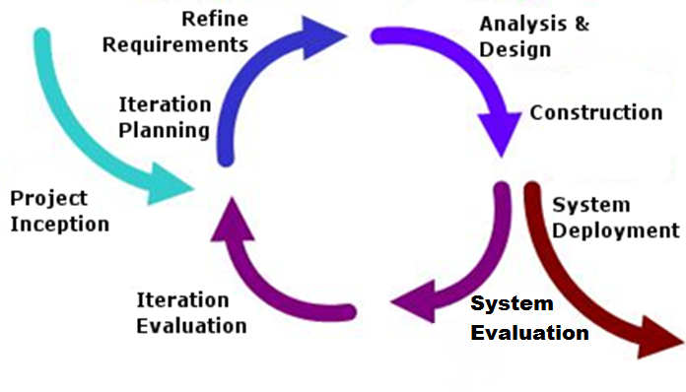
Unified Process is an Incremental Process
Notes:
“Design a Little, Code a Little, Test a Little”

Slide 14
The Unified Process Workflows
UP defines Workflows¹ that describe the activities and artifacts to be produced by the development team during each iteration.
UP defines these Workflows:
Iteration Planning
Requirements Workflow
Analysis Workflow
Design Workflow
Implementation Workflow
Test Workflow
We will briefly describe each of these workflows in this section and dedicate entire sections to some in later sections.
Notes:
1. UP Workflow have the same meaning as Phases in a Waterfall Process. Each iteration executes these UP Workflows.

Slide 15
Project Inception
Before the first iteration, the team and customer meet to decide on the features that the system will deliver.
Features are broad and shallow description of needed functionality.
Other activities also take place during inception which we covered when discussing the Waterfall process.
Business plan, preliminary schedule and budget, others.

Slide 16
Iteration Planning
The SME and development team meet at the start of each iteration to decide which of the remaining features are to be completed during the current iteration.
Recall that each iteration delivers completed features. This is important if the team is to eventually finish.
Any problems identified by the previous iteration’s evaluation are also scheduled to be addressed in the current iteration.
Problems identified when the SME and customer were given to opportunity to use the system at System Evaluation.
The end of Iteration Planning results in a list of features which the team feels they can complete during the iteration.

Slide 17
Requirements Workflow
The general goal of the requirements workflow is understanding and capturing the client’s problems / needs.
Ensuring that the developers understand the client’s problem.
Ensuring that the client understands what the developers think they understand.
Notes:
There is a two-way flow of information between SME and Dev team.
The SME provides an informal description of their needs and the team describes back what they think the SME is requesting. This keeps misunderstandings and other disconnects from the requirements.

Slide 18
Requirements in an Iterative Process
The requirements activity focuses on better understanding the features selected for delivery in the current iteration.
Unlike a waterfall process where all features are analyzed for requirements.
The team does a narrow and deep dive into only the selected features.
The focus on specific features results in better a better quality of requirements.
The focus produces requirements in a short time avoiding the fatigue the team suffers from prolonged analysis.
Notes:
1. The cost of producing the system vs the return in investment i.e. how long before the system generates revenue equal to development costs. Revenue may be customer payment for services (a web service) or reduced cost of operations (automating a business process).

Slide 19
Analysis Workflow
The goal of the analysis workflow is to refine the requirements and develop detailed knowledge of the problem domain.
Where the requirements workflow produces requirements that are generally textual and not always precise, the analysis workflow begins the process of creating the precise specifications needed to construct the system.
This is accomplished by building models (UML, GUI, scenarios) that identify and describe the entities and services needed to build the system.

Slide 20
Analysis in an Iterative Process
Again, the team is able to focus on the analysis of a small set of features.
The team, and people in general, can more easily produce the correct and complete description of the problem domain.
The team produces the same UML models and other artifacts.
We will be discussing Analysis activities in a later section.

Slide 21
Design Workflow
The Requirements and Analysis Workflow workflows capture what the system needs to do.
A goal of the Design Workflow is to describe how the system does it.
The Design Workflow refines the models produced during analysis to the point that those models can be coded.
The Design Workflow adds detail to the classes / components identified during analysis. For example…
Design models define software services (classes / methods).
Design models include details concerning algorithms, data structures, database schema, user interfaces, and other decisions needed to implement the system.

Slide 22
Design in an Iterative Process
The team again is able to focus analyzing a small set of features.
The team produces the same UML models and other artifacts.
We will be discussing Design activities in a later section.

Slide 23
Implementation Workflow
The Implementation Workflow goal is to construct the system using the chosen languages, tools, and other technologies.
Programming language, operating system, cloud providers, application frameworks and libraries, databases, GUI libraries, and others.
During implementation, software components are coded and tested.
Unit Test (code) is written that exercises individual components (classes) to ensure that the class operates as required.
Implementation requires the combined effort of multiple developers each of which is responsible for some component…
And whose individual contributions must be integrated into a functioning whole.

Slide 24
Implementation in an Iterative Process
The goal is to completely implement the selected features.
GUI Screens, Database Schema, Business Rules, etc.
At the iteration’s end, no further work should be needed before the project’s end.
Beyond the work needed to address client concerns or regressions (bugs) introduced by future iterations.
At the iteration’s end, the team should be able to demonstrate the completed feature to the customer.
The customer should be able to use and evaluate these features in their final form.
The customer can then either signoff or make suggestions on changes needed to be addressed in the next iteration.
This allows the team to change / modify features while the design and implementation is fresh in their memories.

Slide 25
Test Workflow
The goal of the Test Workflow is to ensure that the integrated system is completely and correctly implemented.
That the system provides the features requested by the client according to the requirements.
That the system is free of bugs and faults.
This type of testing is referred to as “Integration Testing”.
Integration Testing…
Is traceable back to the system’s requirements.
Is the responsibility of a QA team separate from the developers.
Is performed against the system that has been constructed, installed, and executes in an environment identical to production.

Slide 26
Testing in an Iterative Process
Testing of the completed features is executed during a meeting held on the last day of the iteration.
Meeting is usually called the ‘End of Iteration Demonstration’.
Customer and users are invited during which the iteration’s accomplishments are demonstrated.
The attendees are able to use the system within the scope of the features completed to date.
The attendees are able to point out problem, make suggestions which they feel will make the system useful.
Often, a full QA Integration Testing is performed on the system before being put into production.

Slide 27
The Unified Process Phases
The UP is an Incremental (Iterative) Process.
During each iteration, the requirements, analysis, design, implementation, and test workflows are repeated.
The end of each iteration produces a new version of the system with additional capabilities / features.
An interesting feature of UP is its recognition that the emphasis placed on workflows change throughout the project lifecycle.
Early in the project, requirements and analysis are important.
Midway through, design and implementation are emphasized.
Towards the end, implementation and testing is the focus.
This is because developer’s knowledge of the system improves over time, and requirements and analysis are less likely to change.

Slide 28
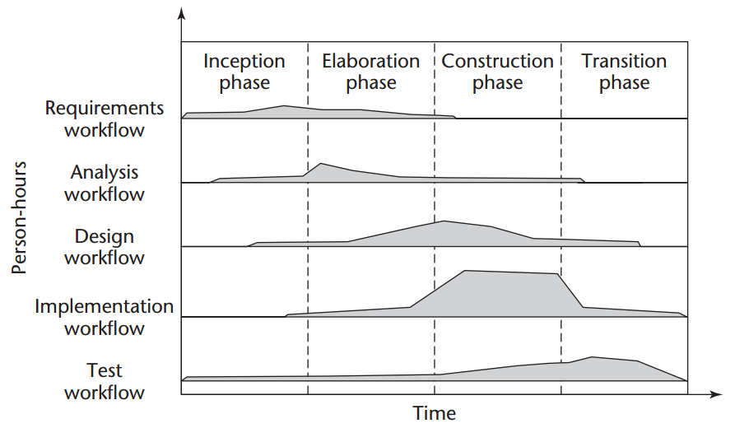
Workflow Emphasis during each UP Phase

Slide 29
The importance of phases is in helping the development team understand how to apply UP
Where should the team’s efforts be concentrated at different points in the project lifecycle?
When should specific artifacts be completed?
The Business Model should be completed by the end of the Inception Phase, but may evolve throughout the project lifecycle.
Requirements should be 40% completed by the end of the Inception Phase and 90% by end of the Elaboration Phase.
The Database Schema should be started during Inception and finished by the end of Elaboration.
UP Phases help to identify when the project is in trouble.
For example, there is likely a problem if the project is half though its schedule and requirements are still being updated.
Notes:
Developer want to know “Are We Doing It Right?” The four phases make suggests about which artifacts should be finished at what parts of the project lifecycle. Like waterfall but at a broader scope.

Slide 30
The Inception Phase Deliverables
By the end of the Inception Phase the team should have produced:
The decision whether the system will be worth the investment needed to build it (Business Model).
The initial version of the system’s requirements which will continue to evolve to the end of the Elaboration Phase.
A rough idea as to the project’s schedule and so its budget.
What are the risks and other problems that need to be overcome.
The documentation as described in section 3.10.1 of the text.

Slide 31
The Elaboration Phase Deliverables
By the end of the Elaboration Phase the team should have produced:
The completed requirements (or 90% anyway).
The “Risk List” document that identifies the risk items that threaten the project’s success.
The ‘completed’ schedule and budget (Project Management Plan).
The mostly completed (80-90%) system’s architecture (high-level system design).
The mostly completed (70-80%) the analysis artifacts.
Other documents and models as described in section 3.10.2.

Slide 32
The Construction Phase Deliverables
By the end of the Construction Phase the team should have produced:
The system’s design should be complete i.e. no major design changes.
All items on the Risk List should be addressed.
A release of the system with most (if not all) of its features completed i.e. a beta release.
Initial versions of the user’s manual, installation manual, etc.
Other items as described in section 3.10.3.

Slide 33
The Transition Phase Deliverables
By the end of the Transition Phase the team should have delivered a complete and correct system including updated design models and other documentation.

Slide 34
Managing a Software Development Process
The organization should monitor the execution of the software development process throughout the project’s lifecycle.
A process should include a set of activities whose purpose is to:
Measure the project’s actual progress, compare with expected progress, and take appropriate actions.
Identify and track unknown or risky issues to be addressed early in the project lifecycle.
Manage and secure the protection of the many artifacts built during the project lifecycle e.g. document and source code control.
Others to be discussed…
These are known as “Umbrella Activities” because they encompass, or cover, the overall development process.

Slide 35
These and other umbrella activities will be discussed in the following sections…
Tracking Project Progress | Tracking the development team’s progress to date and comparing to expected progress. Work Breakdown Structure (Project Schedule) For example, tracking the number of completed system features.
Risk Management | Identifying features or other issues that place the project ‘at risk’ of an unsuccessful conclusion. E.g. Ability to provide a required transaction rate. E.g. An especially complex interface, algorithm, or workflow that is not well understood and may require prototyping. Risk Management includes recording project risks and tracking progress towards understanding and addressing the risk items.

Slide 36
These and other umbrella activities will be discussed in the following sections…
Maintaining Development Artifacts | Protecting the project’s artifacts against corruption or loss. The use of a Source Code Repository (Git or SVN). Versioning artifacts and version tagging. Includes all artifacts e.g. HTML, SQL, Images, Build Scripts, XML and other documents as determined by the technology
Maintaining Project Documentation | Activities which has the team both creating and updating project documentation that describes requirements, design, and other aspects of the project. The use of a Project Management Tools (Jira, MS Project) to track progress, issues, risks, bugs, etc. The use of Document Repository (Jira, SharePoint) to maintain requirements, analysis, design, etc. documents.
Notes:
Source code Repository and Project Management are accessed by the development team, the documents stored in the Document Repository are of interest to all project stakeholders.

Slide 37
These and other umbrella activities will be discussed in the following sections…
Testing | Assuring that testing appropriate to the project’s criticality is being performed. Unit Test: Code design to test individual software components. Integration Tests: Procedures that validate the system’s correct implementation.

Slide 38
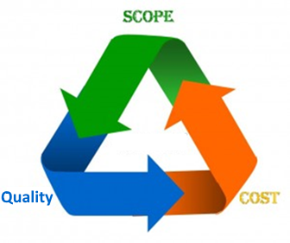
Project Management Tradeoff
The Desire: Customers want systems with many features, produced at minimum cost, and they want it to perform perfectly.
The Reality: They can have a correct system, an inexpensive system, or a system with many complex features…
... but they can have only two.
There is a tradeoff between these three qualities.
If they want to increase scope (features), they will have to increase budget or decrease quality.
If they want to decrease costs, they must reduce scope or decrease quality.
If they want quality systems, they must decrease scope or increase cost (schedule).
Notes:
If you want to increase scope, you will increase time or sacrifice quality.
If you want to decrease costs, you must decrease scope or decrease quality.
If you want to increase quality you need to decrease scope or increase cost.

Slide 39
Actively Improving a Software Development Process
How can an organization improve its software development process?
Reduce number of incorrect or missing requirements.
Improve the accuracy of estimates of the time and resources needed to complete the project.
Can an organization improve the quality of the software products it produces?
Decrease the number of defects found both during development and after delivery to the customer.
Can an organization ensure its process is followed by the developers?
Can an organization improve the effectiveness of its process?

Slide 40
Capability Maturity Model Integration (CMMI)
The Capability Maturity Model Integration is a process that helps organizations streamline process improvement and encourage productive, efficient behaviors that decrease risks in software products and service development.
The premise is that if the organization actively improves their process, the quality of the systems produced will improve.
More often, problems in software development don’t arise from bad process, but when organizations don’t have or don’t follow their process.

Slide 41
Capability Maturity Model Integration (CMMI)
The CMMI is a strategy for evaluating the effectiveness of the software development process exercised by an organization.
The CMMI provides a means of evaluating and improving the quality of the software development process.
CMMI does not describe a process i.e. the phases, activities, or artifacts of the organization’s development process.
CMMI describes practices followed by the organization that rates (ranks) how effectively they are executing their specific software development process.

Slide 42
Capability Maturity Model Integration
CMMI describes a model used to categorize the effectiveness of an organization’s current development process.
CMMI describes five levels (1-5) of conformance.
Each level describes an increasing commitment to defining, documenting, enforcing, monitoring, and improving the organization's software development process.
Organizations fall into one of these five categories with level one being the least desired.

Slide 43
CMMI Levels
CMMI Maturity Levels
1. Initial Level | The organization has no development process.
2. Repeatable Level | The organization documents a repeatable software development process.
3. Defined Level | The organization formalizes the process’s execution with procedures to be followed by project teams.
4. Managed Level | Organization monitors the process execution to quantify the quality of its execution by project teams.
5. Optimizing Level | The organization makes adjustments to their process aimed at improving the quality of the software produced.
http://www.tutorialspoint.com/cmmi/cmmi-maturity-levels.htm

Slide 44
Level One: Initial Level
The organization has no defined process.
There is no planning or requirements gathering.
There is no monitoring of the project’s execution.
No tracking of progress or awareness of when the project is expected to end or how much it will cost.
Under most circumstances a level one process will result in unmanageable chaotic projects producing poor quality.
However, Level One could work when:
The project is small and staffed by qualified developers.
The project goals are open-ended and constantly evolving.
For example, an academic research project.

Slide 45
Level Two: Repeatable Level
The organization begins the effort of using a process in their development projects.
The organization defines and documents a process to the point that it is repeatable.
The process can be applied to multiple projects.
Basic project management practices are used to define budgets and schedules with an estimated end date.
However, the organization does little to ensure process is practiced.
There is little review or oversight of the process’s execution.
Sufficient time is not budgeted to the developers executing the process.
The process is ignored or minimum executed with little effect.

Slide 46
Level Three: Defined Level
A process is well defined, documented, and communicated throughout the organization.
Standards, procedures, tools, and suggested practices are well documented.
Schedules and budgets are allocated to include following the process.
The artifacts generated by the process are specified.
Requirements, analysis, and design models and documents.
Project schedule and budget are documented.
The organization’s management emphasizes and enforces the process utilization across all projects.
Projects are required to hold reviews where process-mandated artifacts are reviewed for correctness and quality.

Slide 47
Level Four: Managed Level
The organization actively measures its project’s performance.
The process identifies quantifiable metrics (measurements).
E.g. The number of requirements changes after Elaboration Phase.
E.g. The number of defects found during integration (QA) testing.
The organization defines acceptable levels for these metrics which projects strive to meet or better.
The collected metrics are analyzed to identify problems that adversely effect project quality. Problems that are then corrected.
Care must be taken to avoid unfairly penalizing a project with special circumstances.
Acceptable metrics need to be defined on a per-project level.

Slide 48
Level Five: Optimizing Level
The organization strives to improve their process.
Typically using metrics gathered across all project executions.
The organization analyzes the performance of the process itself looking for areas of improvement.
E.g. If many projects are experiencing changing requirements late in the project lifecycle, how can requirements gathering be improved?
The organization strives to correct these weakness by analyzing the root causes and making appropriate changes to the process.
E.g. Hire a Business Analyst to aid the development team in the collection of project requirements.

Slide 49
CMMI Compliance
Once an organization integrates with CMMI, the organization can choose be audited by a third party that will certify how well the organization is executing its process.
The organization will be rated by these auditors as maintaining, or executing at, one of the five maturity levels.
A rating is an assurance to both the organization, and the organization’s customers, that a process is being maintained.
Proving reassurance to the customer that the software and other products will be of a high quality i.e. correct, reliable, etc.
Much like ISO standards for food, drugs, components, and other manufactured products.

Slide 50
CMMI Compliance
Auditing provides the organization the benefits of maintaining a CMMI compliant process.
E.g. Purchasing liability insurance at a reduced rate.
Avoiding the financial and other liabilities that will arise from products of poor quality.
The CMMI certification is a marketing advantage when the organization is competing for contracts or other forms of work.
E.g. A telecommunications company (NEC) can offer quantifiable metrics of the quality of their equipment to customers (Verizon).
Assurance to the customer that the products / services provided by a highly-rated organization are likely to be of a higher quality than an unrated competitor.

Slide 51
CMMI Drawbacks
A high level CMMI conformance requires significant resources in both practicing and monitoring the process execution.
Following levels 4 & 5 requires significant resources.
Level 4 compliance requires the collection of metrics, review meetings, tools and practices needed to enforce the process.
Level 5 requires both level 4 resources plus staff to manage the effort of evaluating and optimizing the process.
However, organizations having highly critical applications may find that the discipline and control over the project’s execution offered by a CMM level 4 or 5 process are justified.
Notes:
Some sources have deemed CMMI as obsolete in the ‘age of agility’. But studying CMMI serves to illustrate how an organization can support their development process in order to produced systems of the highest quality. High quality is especially important with critical system or systems that are large in scope and require the combined contributions of many engineers and technicians.

